Slide 1
EMBEDDED SYSTEMS LAB
TOPIC : WIFI-BOT CAR USING NODEMCU
HARINI.S – 2018115035
NAUVYASHREE - 2018115060

Slide 2
NodeMCU ESP8266 WIFI CAR
HARDWARE REQUIRMENTS :
1. NodeMCU ESP8266(CP2102)
2.L298N Motor Driver
3.BO Motor or Gear Motor
4.BO motor wheel
5.2s Li-po Battery
6.Jumper Wire
7.MDF
SOFTWARE REQUIREMENTS :
1.Arduino IDE

Slide 3
NodeMCU Car Is Controlled By Using Android Mobile
Phone Instead Of Any Other Method Like Buttons, Gesture, Etc.
Here Only Needs To Touch Button In Android Phone To
Control The Car In Forward, Backward, Left And Right
Directions. So Here Android Phone Is Used As Transmitting
Device And NodeMCU ESP8266 Placed In Car Is Used As
Receiver. Android Phone Will Transmit Command Using Its
In-Built Wi-fi To Car So That It Can Move In The Required
Direction Like Moving Forward, Reverse, Turning Left,
Turning Right And Stop.

Slide 4
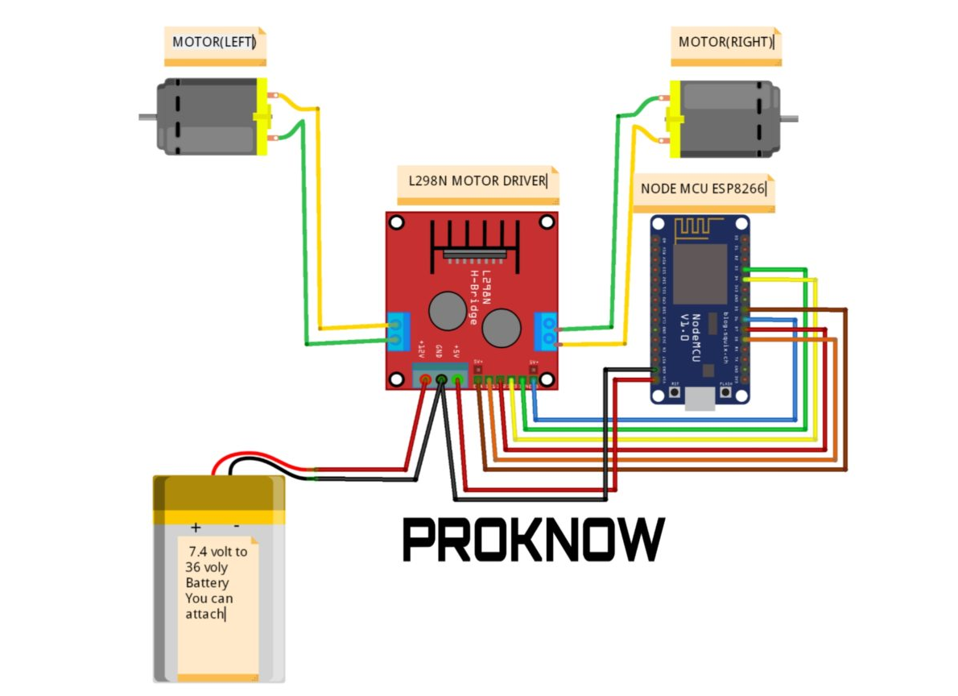
ARCHITECTURE OF NodeMCU-Wifi CAR

Slide 5
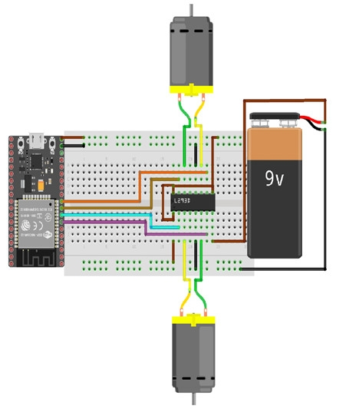
DIAGRAM :

Slide 6

DEMO VIDEO :

Slide 7
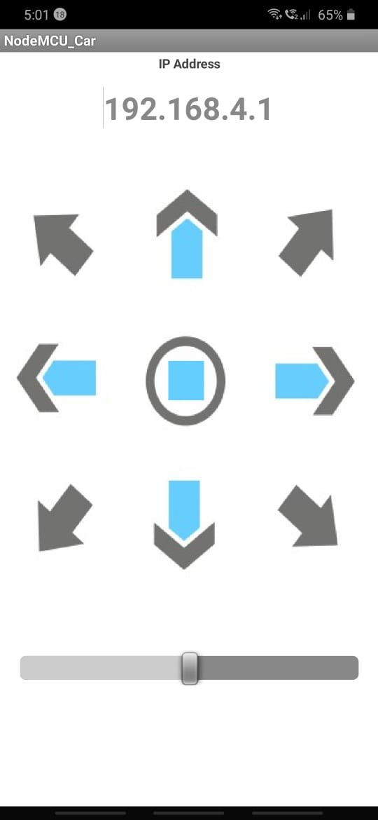
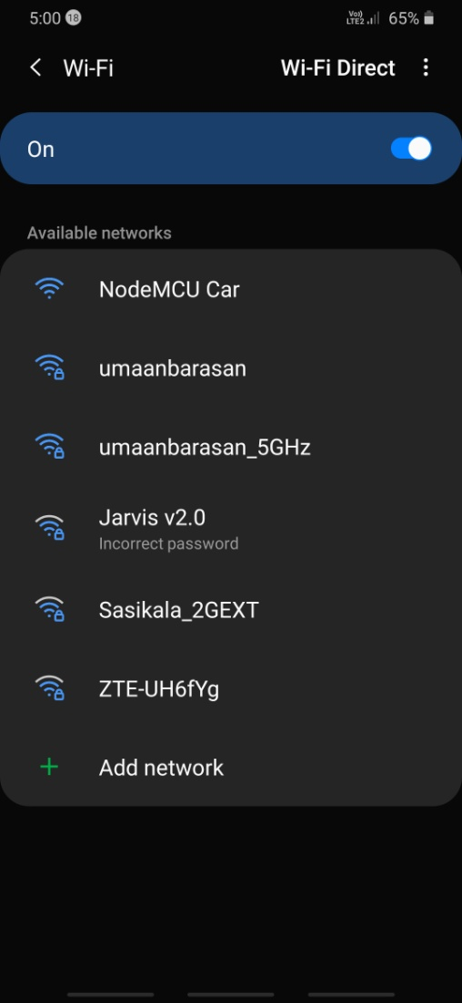

Slide 8
NodeMCU CAR CODE :
#define ENA 14 // Enable/speed motors Right GPIO14(D5)
#define ENB 12 // Enable/speed motors Left GPIO12(D6)
#define IN_1 15 // L298N in1 motors Right GPIO15(D8)
#define IN_2 13 // L298N in2 motors Right GPIO13(D7)
#define IN_3 2 // L298N in3 motors Left GPIO2(D4)
#define IN_4 0 // L298N in4 motors Left GPIO0(D3)
#include <ESP8266WiFi.h> #include <WiFiClient.h>
#include <ESP8266WebServer.h>
String command; //String to store app command state.
int speedCar = 800; // 400 - 1023.
int speed_Coeff = 3;
const char* ssid = "NodeMCU Car";
ESP8266WebServer server(80);
void setup()
{
pinMode(ENA, OUTPUT);
pinMode(ENB, OUTPUT);
pinMode(IN_1, OUTPUT);
pinMode(IN_2, OUTPUT);

Slide 9
pinMode(IN_3, OUTPUT);
pinMode(IN_4, OUTPUT);
Serial.begin(115200); // Connecting WiFi
WiFi.mode(WIFI_AP);
WiFi.softAP(ssid);
IPAddress myIP = WiFi.softAPIP();
Serial.print("AP IP address: ");
Serial.println(myIP); // Starting WEB-server
server.on ( "/", HTTP_handleRoot );
server.onNotFound( HTTP_handleRoot );
server.begin();
}
void goAhead()
{
digitalWrite(IN_1, LOW);
digitalWrite(IN_2, HIGH);
analogWrite(ENA, speedCar);
digitalWrite(IN_3, LOW);
digitalWrite(IN_4, HIGH);
analogWrite(ENB, speedCar);
}

Slide 10
void goBack()
{
digitalWrite(IN_1, HIGH);
digitalWrite(IN_2, LOW);
analogWrite(ENA, speedCar);
digitalWrite(IN_3, HIGH);
digitalWrite(IN_4, LOW);
analogWrite(ENB, speedCar);
}
void goRight()
{
digitalWrite(IN_1, HIGH);
digitalWrite(IN_2, LOW);
analogWrite(ENA, speedCar);
digitalWrite(IN_3, LOW);
digitalWrite(IN_4, HIGH);
analogWrite(ENB, speedCar);
}
void goLeft()
{ digitalWrite(IN_1, LOW);
digitalWrite(IN_2, HIGH);

Slide 11
analogWrite(ENA, speedCar);
digitalWrite(IN_3, HIGH);
digitalWrite(IN_4, LOW);
analogWrite(ENB, speedCar);
}
void goAheadRight()
{
digitalWrite(IN_1, LOW);
digitalWrite(IN_2, HIGH);
analogWrite(ENA, speedCar/speed_Coeff);
digitalWrite(IN_3, LOW);
digitalWrite(IN_4, HIGH);
analogWrite(ENB, speedCar);
}
void goAheadLeft()
{
digitalWrite(IN_1, LOW);
digitalWrite(IN_2, HIGH);
analogWrite(ENA, speedCar);
digitalWrite(IN_3, LOW);
digitalWrite(IN_4, HIGH);
analogWrite(ENB, speedCar/speed_Coeff);

Slide 12
}
void goBackRight()
{
digitalWrite(IN_1, HIGH);
digitalWrite(IN_2, LOW);
analogWrite(ENA, speedCar/speed_Coeff);
digitalWrite(IN_3, HIGH);
digitalWrite(IN_4, LOW);
analogWrite(ENB, speedCar);
}
void goBackLeft()
{
digitalWrite(IN_1, HIGH);
digitalWrite(IN_2, LOW);
analogWrite(ENA, speedCar);
digitalWrite(IN_3, HIGH);
digitalWrite(IN_4, LOW);
analogWrite(ENB, speedCar/speed_Coeff);
}
void stopRobot()
{
digitalWrite(IN_1, LOW);

Slide 13
digitalWrite(IN_2, LOW);
analogWrite(ENA, speedCar);
digitalWrite(IN_3, LOW);
digitalWrite(IN_4, LOW);
analogWrite(ENB, speedCar); }
void loop() {
server.handleClient();
command = server.arg("State");
if (command == "F")
goAhead();
else if (command == "B")
goBack();
else if (command == "L")
goLeft();
else if (command == "R")
goRight();
else if (command == "I")
goAheadRight();
else if (command == "G")
goAheadLeft();
else if (command == "J")
goBackRight();

Slide 14
else if (command == "H")
goBackLeft();
else if (command == "0")
speedCar = 400;
else if (command == "1")
speedCar = 470;
else if (command == "2")
speedCar = 540;
else if (command == "3")
speedCar = 610;
else if (command == "4")
speedCar = 680;
else if (command == "5")
speedCar = 750;
else if (command == "6")
speedCar = 820;
else if (command == "7")
speedCar = 890;
else if (command == "8")
speedCar = 960;
else if (command == "9")
speedCar = 1023;

Slide 15
else if (command == "S")
stopRobot();
}
void HTTP_handleRoot(void)
{
if( server.hasArg("State") )
{
Serial.println(server.arg("State"));
}
server.send ( 200, "text/html", "" );
delay(1);
}

